Slide 1

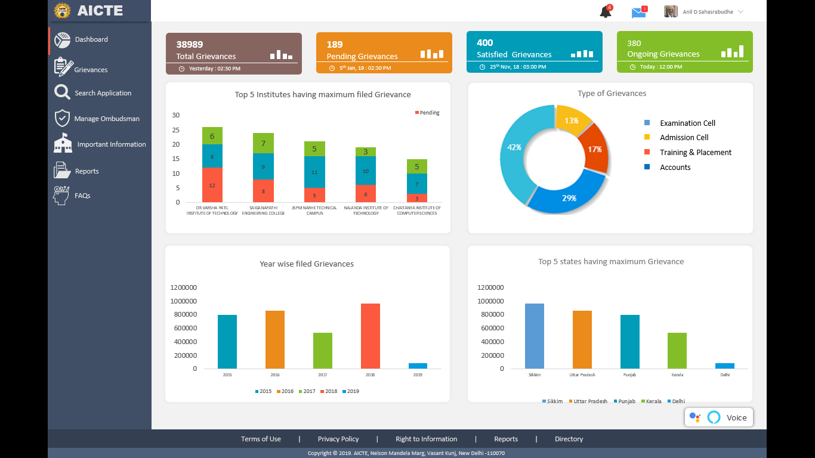

Future Scope
Future Scope | Smart India Hackathon
www.aictegrms.in

Slide 2

1
Features and Scalability
<Add Image>
Highlights
Android and IOS app can be developed for the application
Scope to accept the grievances around the globe regarding approved courses of aicte.
Government and Statutory & Professional bodies, RTI grievances can be filled in this portal.
Future Scope | Smart India Hackathon
www.aictegrms.in

Slide 3

2
Machine Learning implementations
<Add Image>
Highlights
Automatically provide resolution to such grievances which are raised earlier.
Voice integrated service for the application
Character Recognition to find out the summary and validation of uploaded documents.
Future Scope | Smart India Hackathon
www.aictegrms.in

Slide 4

3
Security and Deployment
<Add Image>
Highlights
2 step authentication for higher authority login.
DDOS attack prevention using machine learning to ensure 24x7 services to all users.
Future Scope | Smart India Hackathon
www.aictegrms.in

